Slide 1
High Strain-Rate Characterization of Magnesium Alloys
Srdjan Simunovic
Oak Ridge National Laboratory
September 23, 2011
Project ID # LM032
This presentation does not contain any proprietary, confidential, or otherwise rstricted information
Notes:
Acknowledge support from the DOE Lightweight Materials Program
Colleagues: Don, Mike, Hanbing, Srdjan, students, etc.

Slide 2
Objective
Provide enabling technologies for use of lightweight materials (Mg alloys) in automobiles by the development of:
  High strain rate test methods
  Methods for characterization of material property degradation (damage) evolution under high rates
  Methods for failure characterization at high rates
  Databases of material properties
  Constitutive models for FEM simulations
Technology developed in this project is directly applicable to Mg alloys and other lightweight materials.
Relevance

Slide 3
Relevance to VT Program
The current designs with lightweight materials result in overdesigned components in order to compensate for the uncertainties in the deformation and failure mechanisms.
Reducing uncertainties in component design greatly improves the overall vehicle system reliability and enables weight reduction (Technical Target: Vehicle Weight).
Vehicle designers need (Barriers C and G):
  Mechanical properties under impact, damage and failure characterization, material and failure models, FEM technology
  Methods for material characterization under impact
  Very limited material data and models are currently available for crashworthiness of Mg alloys
This project develops enabling technologies and material data for use of Mg alloys in automotive structural applications.
Relevance
Notes:
Srdjan’s comments: Links to the previous slide. Barriers are from VT Program Multi-Year Program Plan.

Slide 4
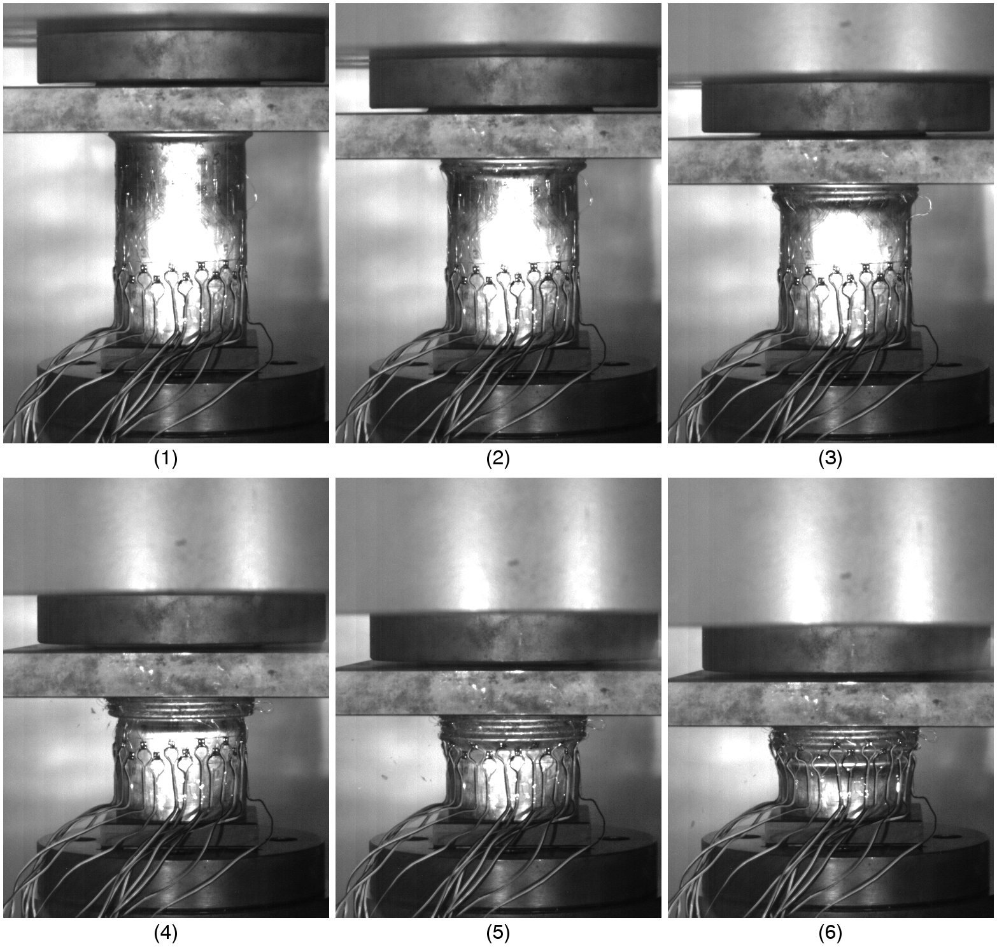
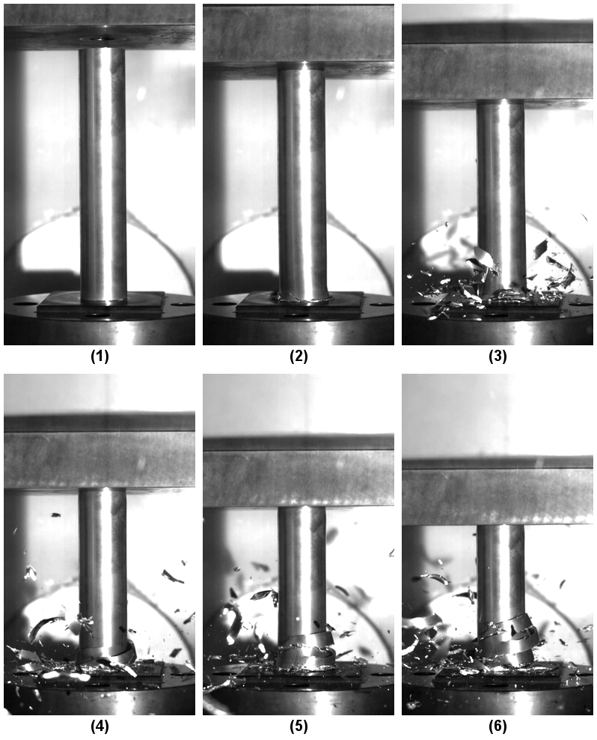
Crashworthiness Tests
HSLA
Mg Alloy
Impact energy dissipation in Mg tube occurs by different process than in the conventional automotive materials.
Vehicle designers need to understand initiation and evolution of internal state and failure processes in Mg alloys as functions of loading type and loading rates.
Technical Approach
Notes:
Srdjan’s comments:
Mg alloys deform drastically different than steels and Al alloys.
For steels the deformation in plastic fold (hinges) can exceed 100%. In Mg alloys that is not possible due to their internal structure, hcp, basal structure, etc. You can expand on your materials science background here.
Deformation in Mg alloys is accompanied with void nucleation, growth, void coalescence, localization and fracture.
We have to account for this new mechanism in experiments, characterization, modeling and design. Designers need material information and models. We are providing them with material information, developing new material characterization tests, and determining the best models for design.

Slide 5
Strain Rates in Automotive Design
Low (quasi-static) rate tests - entire system is in equilibrium at all times
Fast rate tests - single impact pulse travels through the system
Intermediate rate tests (between 1/s and 1000/s) - multiple wave reflections in the system
  Difficult to establish dynamic equilibrium in the sample and the system
  These rates are important because maximum strain rates in automotive crash are in the interval of 10-1000/s (also important for forming)
It is essential to:
  Reduce mass in the system
  Develop lightweight load cells and sensors
  Understand and control oscillations in the system
  Combine multiple measurement techniques for the same data
Intermediate strain rate tests have not been standardized
  Active research field
This project develops new testing methodologies and material information for the strain rates of interest in vehicle design.
Technical Approach
Notes:
Srdjan’s comments:
Automotive crash generates strain rates up to 1000/s. This is a difficult region because we have to account for and manage stress wave dynamics in the equipment and the specimen.
No testing standards in this regime. Active area of research. Just few places around the world.

Slide 6
Approach/Strategy
Develop new methods and procedures for measurement of material behavior at intermediate strain rates.
  Develop test methods, loading equipment, control, sensors, specimens, fixtures.
Test measurements must be based on multiple sensor types.
  We must have multiple data sources for each measured quantity.
Verify measurements throughout the range of strain rates of interest.
  As some sensor types reduce accuracy with increasing speeds, new sensors must gradually take over.
  Validity of a new sensor type must be established in the transition region.
Develop new methods for strain-interrupted tests at high rates.
  Essential for investigation of strain-rate dependency of damage evolution.
  It is easier to speed up than to instantly stop, especially at 500 in/sec.
Investigate formation and growth of voids in Mg alloys using microscopy for strains and strain rates of interest.
Distribute data as soon as possible.
Technical Approach
Notes:
Srdjan’s notes:
Why are we different? We are using multiple sensors for the same information so that we can verify results and get sense of sensor accuracy as the rates change.
We need to investigate new mechanisms of deformation that relate to void nucleation , growth, etc. For that we need to test at different strain rates and see how those mechanisms evolve.
We want to disseminate the results ASAP because vehicle designers need it now. Therefore, everything goes to www.

Slide 7
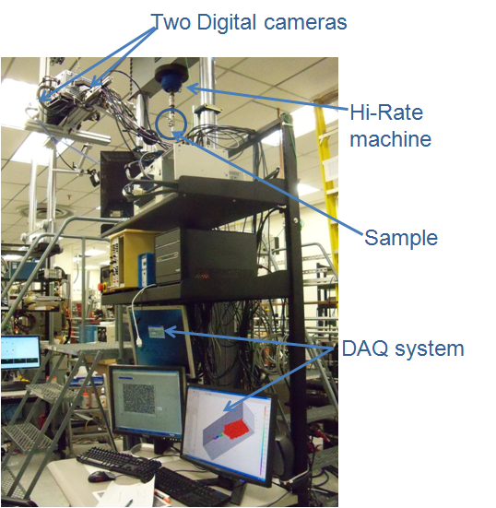
Materials and Test Instrumentation
Materials Tested:
AZ31 sheet metal
AM60B cast (top hat)
AM60B unprocessed
Materials for test development (AHSS)
Custom Designed Hydraulic System
Max Velocity=700 in/s
(18.5 m/sec) over approx. 4 in (100 mm) Range
Load Capacity : 9000 lbs (40 kN) static, 5500 lbs (25 kN) dynamic
Total Stroke: 15.5 in (400mm)
Working Stroke: approx. 7.0 in (175 mm) with slack adapter in the load train
Control: MTS 407 servo - hydraulic controllers, with external command signal (drive file). In-house developed synchronization and DAQ systems.
High speed digital imaging system
Max. Frame rate: 1000000 fps
3D imaging capability for full field displacement map
Control and synchronization of multiple data sources are essential for accuracy at high speeds.
Technical Approach

Slide 8
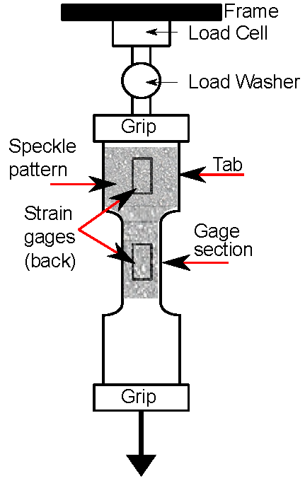
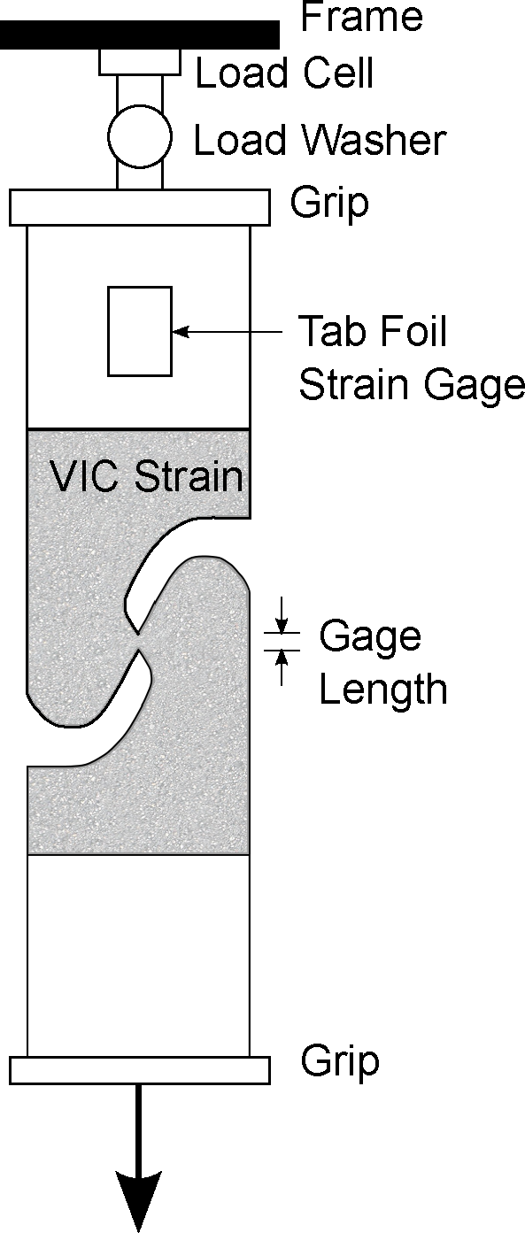
Tests for Intermediate Strain Rate Regime Use Multiple Sensors
Test Instrumentation and Setup
Standard load cells loose accuracy at high rates due to inertia of the devices.
Strain gages on the specimen are used for strain and stress (tab region) measurements.
Optical strain measurements from high speed camera are used for strain measurements across the specimen.
Measurement from different sensors is compared for different strain rates in order to establish correlations and estimate errors.
Specimen and sensor
schematics
Technical Approach
Notes:
Srdjan’s comments:
Schematics. Discuss how multiple data sources are used and correlate.

Slide 9
New Test Setup Provides for Accurate Measurements of High Strains and Rates
1 /s
500 /s
Conventional methods of calculating strains from stroke are not accurate.
  At low strain rate (1 /s), strain calculated from stroke tends to overestimate the average strain of the gage section.
  At high strain rate (500 /s), strain calculated from stroke tends to underestimate the average gage section strain.
Digital Image Correlation (VIC) enables measurement of strains well beyond the range of fast-response bondable foil gages.
Technical Accomplishments
Notes:
Srdjan’s notes:
Describe what happens if we pick stroke data. How far we are off then. Test at high rates lasts for few (up to 20) milliseconds, stroke is not accurate at that time and length scales.

Slide 10
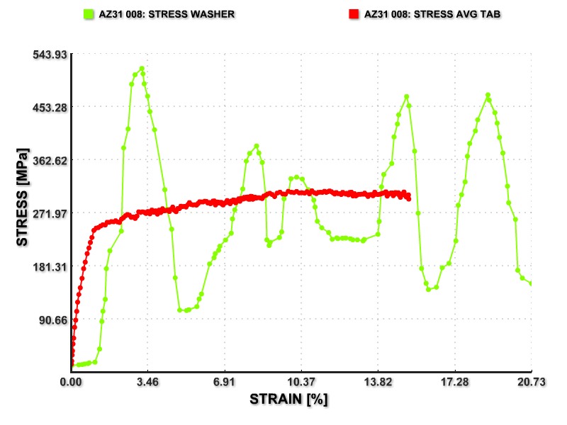
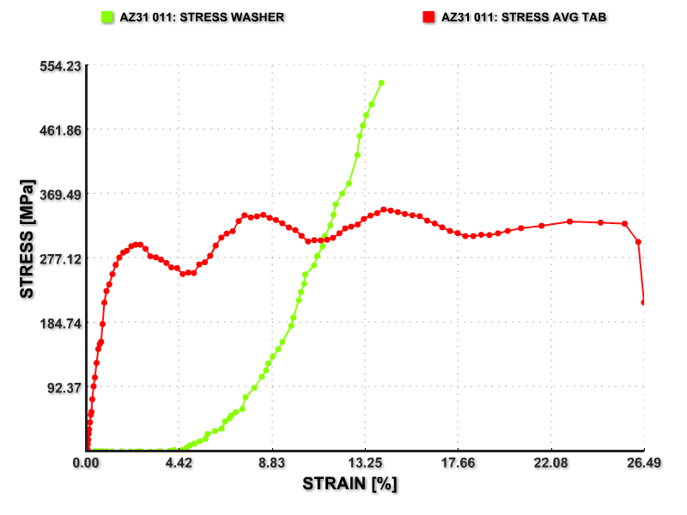
New Strain Rate Testing Method
AZ31 at 100/s
AZ31 at 500/s
Conventional method
(LVDT/Load washer)
LVDT/Load washer
New method
New method
Conventional approaches give inaccurate measurements that need to be filtered and cannot provide data for small strains and for high strain rates.
We accomplished significant improvement in measurements of stresses, strains and strain rates in the intermediate strain rate regime.
Technical Accomplishments

Slide 11
Strain Rate Sensitivity of Mg Alloys in Tension
AZ31
AM60B
Raw data, no filters have been used
Tests are run on the same equipment
Data can be processed and downloaded from the project’s web site

Slide 12
Strain Rate Sensitivity of Mg Alloys in Shear
AM60B
AZ31
Raw data, no filters have been used
The tests show reasonable strain distributions in the test specimens. AM60B fails in fracture mode.
Test data correlates well with the tension tests.

Slide 13
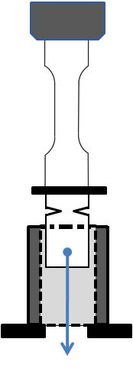
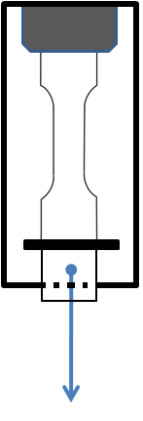
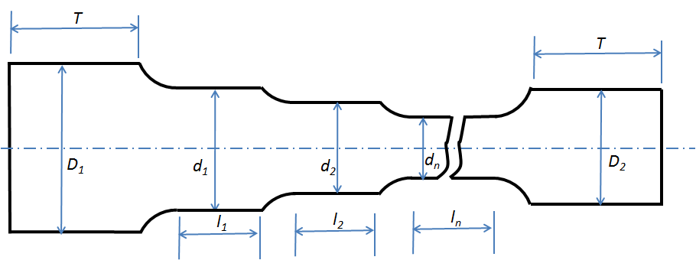
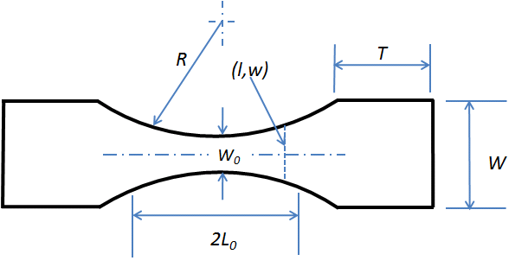
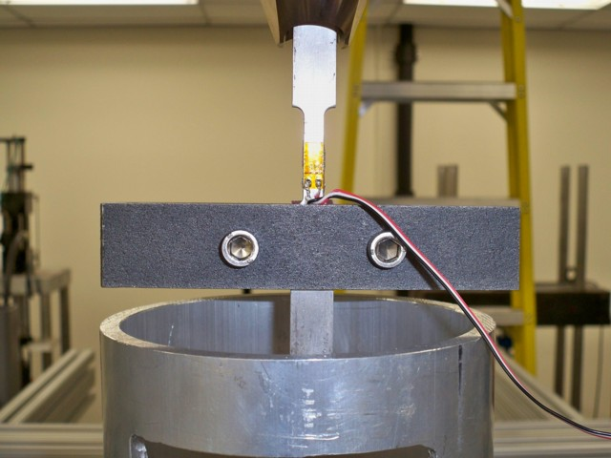
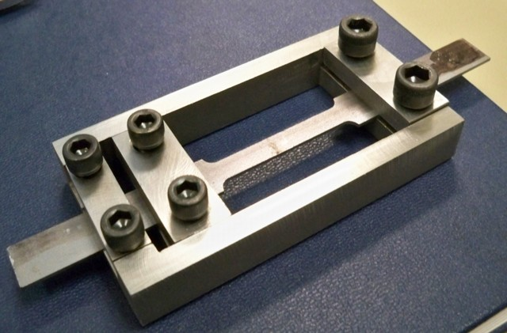
We have Designed New Test Fixtures and Specimens for Prescribed Strain Application at High Strain Rates
Attempts at New Fixture Designs
New Specimen Designs
Multi-gage
Tapered shape
Type I
Type II
Difficult to control
Problems increase with speed
Requires a large number of tests
Scrapped, went with new approach
Reduces the number of tests and specimens
Shape design is determined by modeling
No added mass, simpler, cheaper method
Invention application in process
Technical Accomplishments
Notes:
Srdjan’s notes:
Explain again why we are stopping at high rates. We need to be able to characterize void nucleation, growth, etc. at different rates.
Two initial approaches had problems, describe them shortly.
We then stepped back, totally rethink the approach and came with fundamentally new approach.
Explain how we get multiple data from the same test.
Patent application.

Slide 14
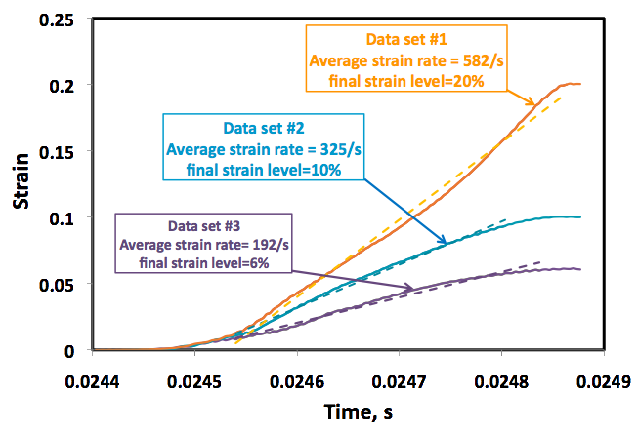
The New Test Generates Multiple Strain Rates in a Single Specimen
The new method generates smoothly increasing strain path to the final strain under reasonably constant strain rate.
Further test development is planned for in order to improve the control of strain and strain rate distribution.
Technical Accomplishments
Notes:
Srdjan’s notes:
Describe success. Linear strain vs time gives constant strain rate.

Slide 15
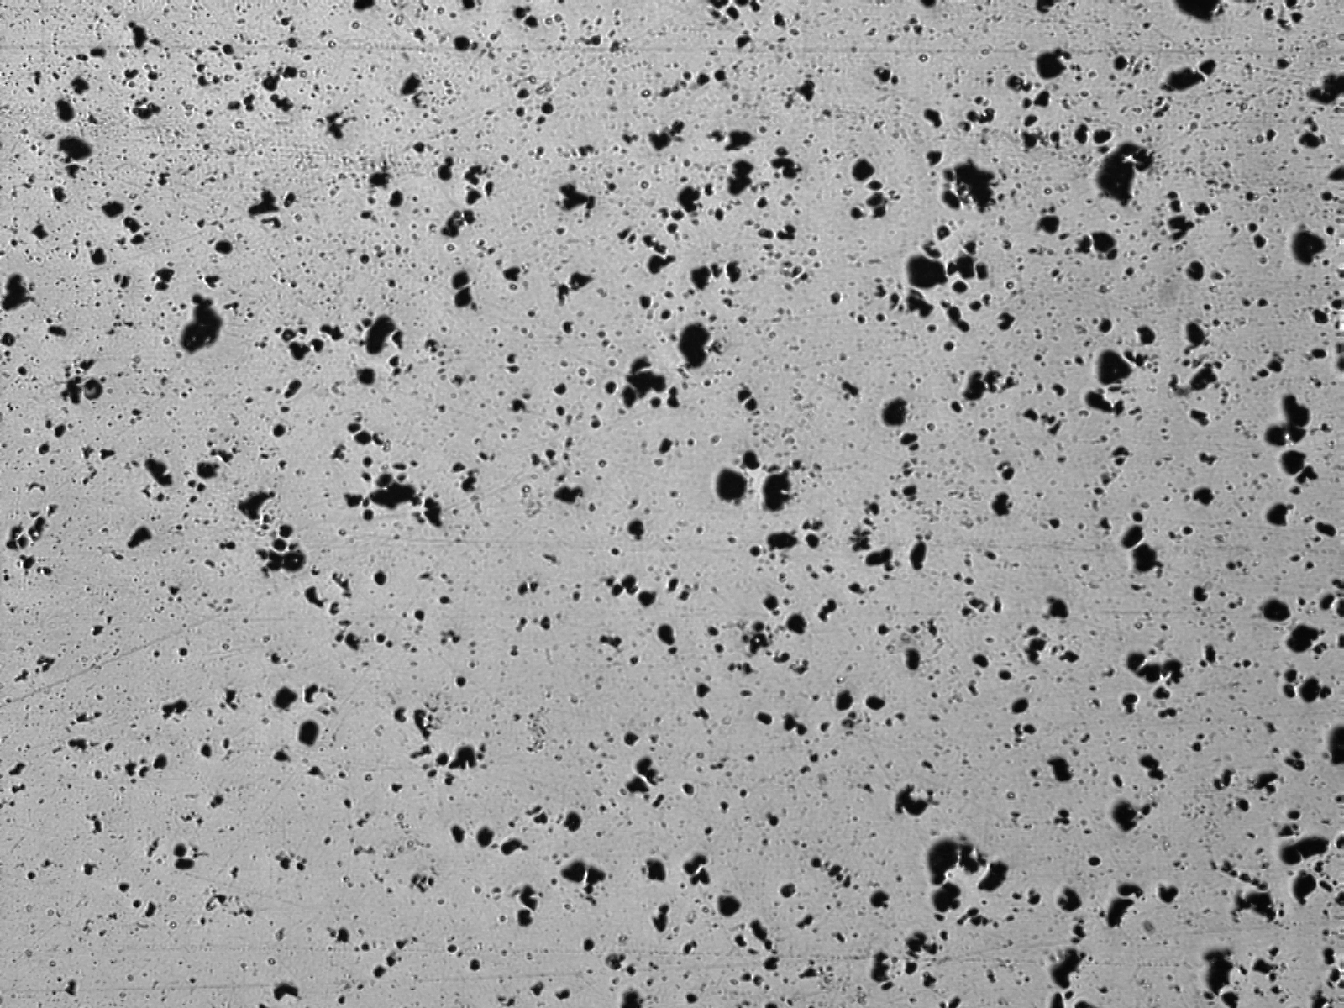

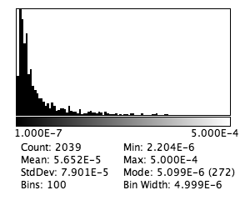
Damage Analysis in Mg Alloys
The void statistics are generated by image processing.
  Data can be used for calibration of micromechanics-based material and failure models for FEM simulations.
Original Image
Discovered Voids
Void Size Distribution
Technical Accomplishments
Notes:
Srdjan’s notes:
Non-uniform distribution across thickness.
We use mostly optical microscopy because the length scale is relevant to mechanical response due to void sizes (as well as nucleation, growth, etc). No money for other resolutions relevant to AZ31.
We use NIH-developed program ImageJ for processing micrographs, and write programs/scripts in imageJ to process images to get void size distribution, void orientation distribution, correlations, etc.
The data is used to understand material behavior and develop parameters for constitutive models (e.g Gurson-type models for plastic deformation of solids with voids).

Slide 16
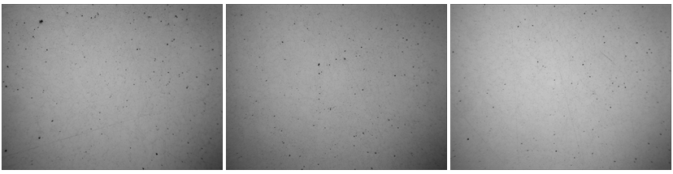
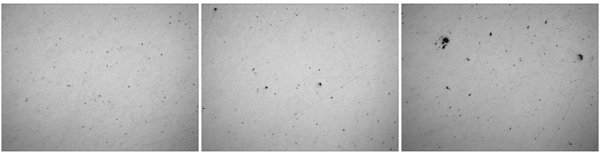
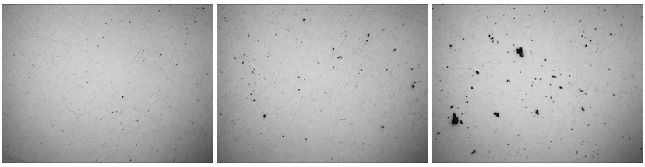
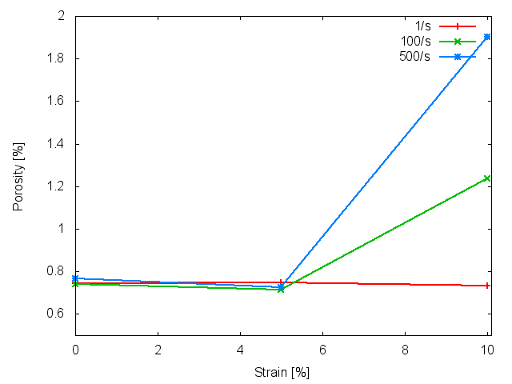
Void Profile Examples for AM60
Results are generated by the interrupted strain method
The tests show that void nucleation and growth (damage) intensifies with strain rates for AM60.
  More test are needed for different initial porosities
.
ε = 1/s
100x
Strain rate
.
ε = 100/s
.
ε = 500/s
.
ε = 100/s
Strain
0% 5% 10%
Technical Accomplishments
Notes:
Srdjan’s notes:
Voids nucleate and grow differently for under different strain rates! Very important for crash design.
We also need to develop new constitutive and fracture models with this feature (future work).

Slide 17
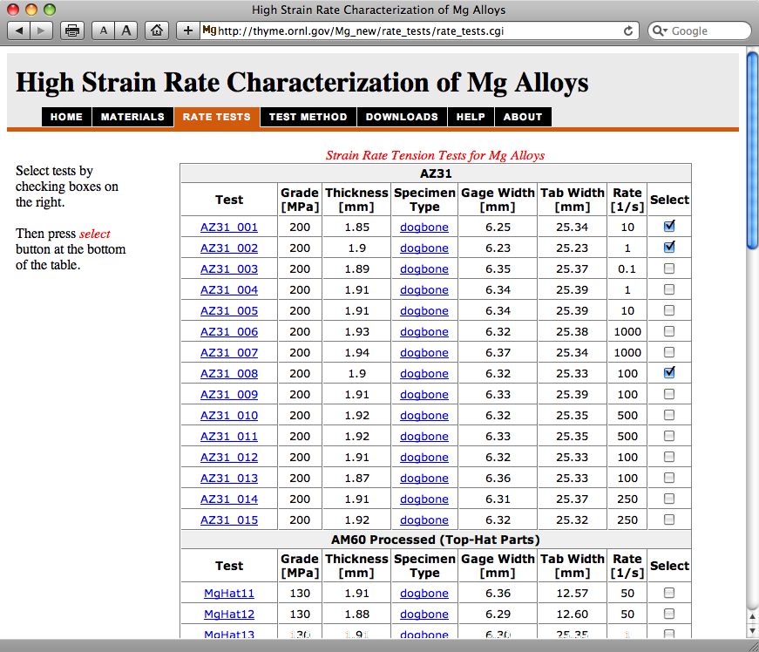
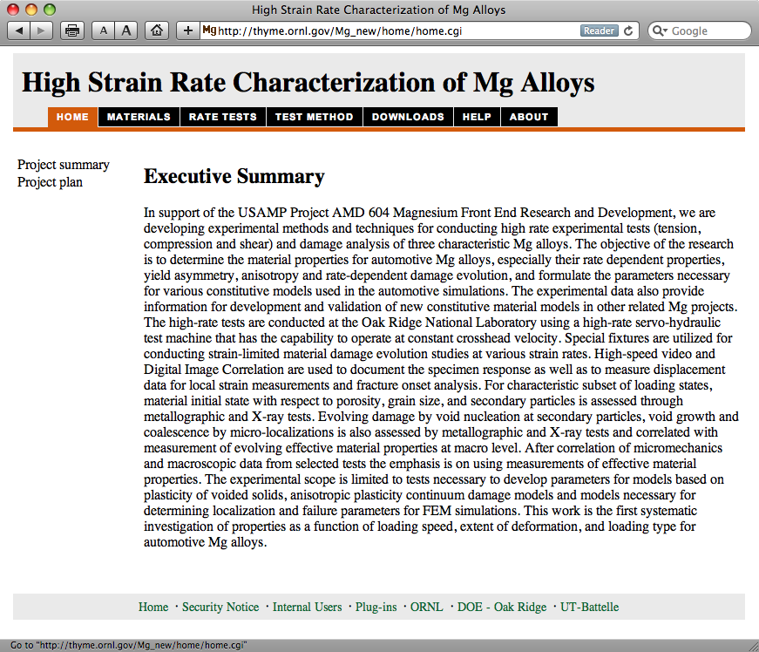
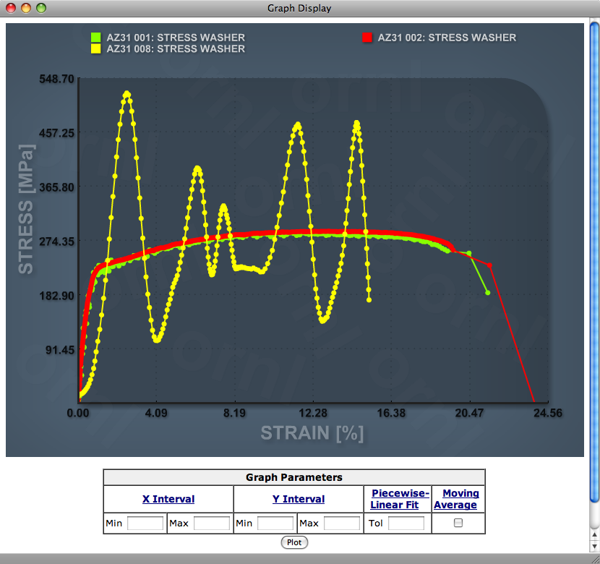
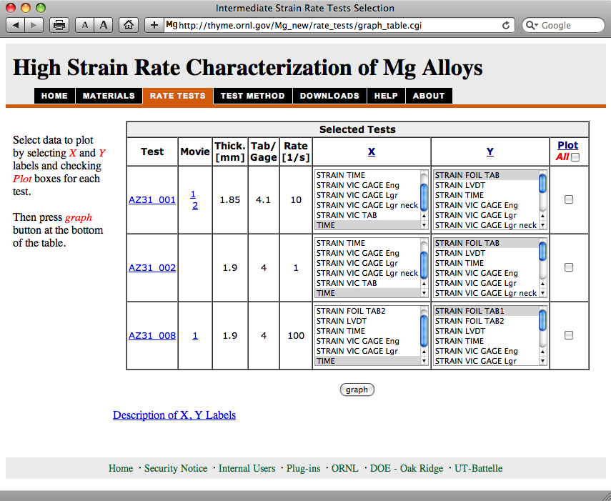
Collaboration and Coordination with Other Institutions
Collaboration with Mg Front End R&D Project
  Materials supplied by OEMs
Technology Transfer
  Test data distributed via www
    http://thyme.ornl.gov/Mg_new
  Users can select/view/process data and download it for FEM material models
  Direct communication to OEMs
Education
  Two postdoctoral students
  8 student interns so far
  9 summer students for 2011
Notes:
Srdjan’s notes:
The most effective and the fastest distribution of results is over www. A lot of traffic, by commercial companies like Boeing, car companies, government agencies DOT, universities. Permanent entry in crash simulation newsletters such as ls-dyna newsletter FEA Information.

Slide 18
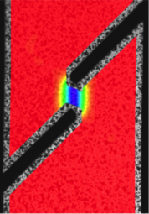


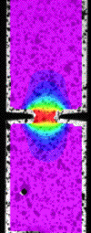
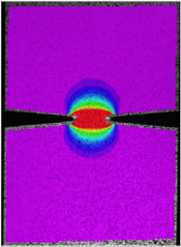
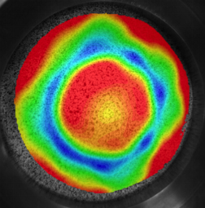
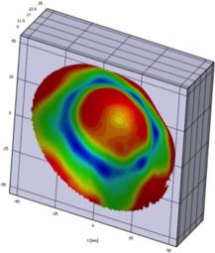
Proposed Future Work
In-depth characterization of damage evolution in Mg alloys of interest to automotive designers at various strain rate conditions, loadings and initial microstructures.
  Develop mechanics-based methods for damage characterization.
Advance technology for intermediate strain rate testing in tension, shear and multi-axial loading configurations.
  Essential for development and calibration of advanced material models for lightweight materials. The damage models require wide region of stress states and loading paths.
  Support development of forming technologies and new material processes such as asymmetric rolling for Mg alloys
Development of methods for characterization of fracture/failure properties of Mg sheet form.
Stress Triaxiality
Notes:
Srdjan’s note:
We are developing enabling technology, testing procedures and material models that are necessary for introduction of lightweight materials into cars.
We are not doing standard experiments. Commercial testing labs are better equipped for that.
Most of the work that we do requires multi-disciplinary expertise and custom equipment development that it is not readily available outside national labs.
Great results, unique capability for interrupting loading at high rates. Mention different void growth for different strain rates.
The developed technology will allow us to gain better insight into Mg alloys, enable their use in cars, reduce weight and reduce demand for oil.

Slide 19
Summary
We have developed and demonstrated test methods for characterization of materials under strain rates typical of vehicle crash.
  Tension and shear configurations were developed.
  Tests provide much needed data for Mg alloy applications.
  Tests are used for material model development and calibration.
A new method for interrupted strain rate tests have been developed that enables characterization of material internal state under intermediate strain rates.
The developed methods can be used to address complex problems of characterization of fracture and failure in sheet materials.
Technology transfer occurs via www
http://thyme.ornl.gov/Mg_new

Slide 20
Technical Back-Up Slides

Slide 21
Project Information on the WWW http://thyme.ornl.gov/Mg_new
Test Method – describes test setup and procedures
Help – usage of test data

