Slide 1
High Strain-Rate Characterization of Magnesium Alloys
Srdjan Simunovic
Oak Ridge National Laboratory
May 9-13, 2011
Project ID # LM032
This presentation does not contain any proprietary, confidential, or otherwise restricted information

Slide 2
Overview
Timeline
Barriers
Project start date FY2008 (4 qtr)
Project end date FY2011
Percent complete 70%
Design data and modeling tools
  Adequate design data (material property databases), test methods, analytical tools (i.e., models), and durability data are inadequate for widespread applications of lightweight materials.
Performance
  Materials needed to achieve the specific performance objectives may not exist today as durable, reliable, well-characterized and understood materials.
Budget
Total project funding
  $825 K
Funding received in FY 2010
  $275 K
Funding for FY 2011
  $200 K
Partners
Mg Front End R&D
Project lead: ORNL
Notes:
Recommended time for this slide: <2 min
The purpose of this slide is to provide some context for evaluating your project and especially your accomplishments.
The information in the left column describes the magnitude and timing of the investment in your project. The information in the right column describes the players and the issues that are to be overcome. Note that the example includes the Technical Targets the project is addressing. This is acceptable if it can be done in a concise manner as shown.
For projects that include multiple partners, please discuss the roles of each and how the overall project is being managed.

Slide 3
Objective
Provide enabling technologies for use of lightweight materials (Mg alloys) in automobiles by the development of:
  High strain rate test methods
  Methods for characterization of material property degradation (damage) evolution under high rates
  Methods for failure characterization at high rates
  Databases of material properties
  Constitutive models for FEM simulations
Technology developed in this project is directly applicable to Mg alloys and other lightweight materials.
Relevance

Slide 4
Relevance to VT Program
The current designs with lightweight materials result in overdesigned components in order to compensate for the uncertainties in the deformation and failure mechanisms.
Reducing uncertainties in component design greatly improves the overall vehicle system reliability and enables weight reduction (Technical Target: Vehicle Weight).
Vehicle designers need (Barriers C and G):
  Mechanical properties under impact, damage and failure characterization, material and failure models, FEM technology
  Methods for material characterization under impact
  Very limited material data and models are currently available for crashworthiness of Mg alloys
This project develops enabling technologies and material data for use of Mg alloys in automotive structural applications.
Relevance

Slide 5
Milestones
Month/Year | Milestone
February 2010 Completed 7/10 | Resolve discrepancies in test measurements and develop force and displacement measurement system for AM60B alloy sheet specimens
April 2010 Completed 11/10 | Complete microscopic analysis for quasi-static damage evolution of internal defects for AM60B
June 2010 Completed 8/10 | Complete tensile strain rate tests of up to 1000/s for AZ31 Mg alloy
September 2010 April 2011 | Complete interrupted tensile loading tests from strain rate tests of up to 1000/s for AZ31 (test matrix extended to include AM60)
Month/Year | Milestone
November 2010 Completed 11/10 | Test design for shear testing under high strain rates
December 2010 Completed 2/11 | Develop constitutive models based on damage evolution under tensile tests AM60B
March 2011 | Shear specimen strain rate tests up to 100 /s
May 2011 | Complete microscopic analysis for strain rate damage evolution of internal defects for AM60B
August 2011 | Develop constitutive models based on damage evolution under tensile and shear tests AM60B

Slide 6
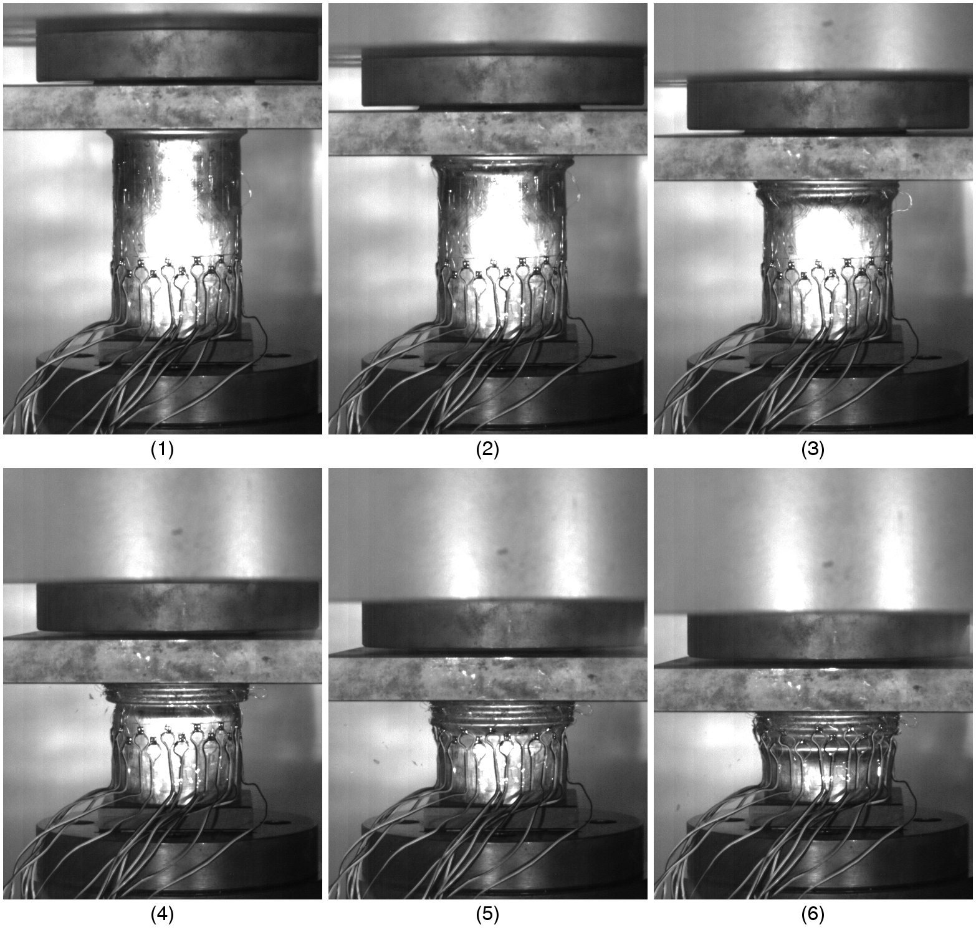
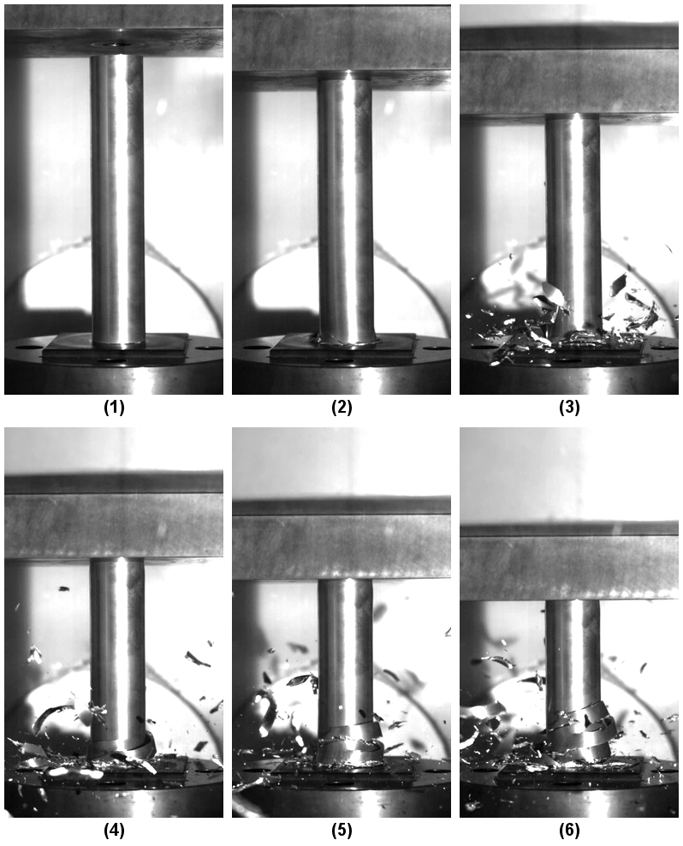
Crashworthiness Tests
HSLA
Mg Alloy
Impact energy dissipation in Mg tube occurs by different process than in the conventional automotive materials.
Vehicle designers need to understand initiation and evolution of internal state and failure processes in Mg alloys as functions of loading type and loading rates.
Technical Approach

Slide 7
Strain Rates in Automotive Design
Low (quasi-static) rate tests - entire system is in equilibrium at all times
Fast rate tests - single impact pulse travels through the system
Intermediate rate tests (between 1/s and 1000/s) - multiple wave reflections in the system
  Difficult to establish dynamic equilibrium in the sample and the system
  These rates are important because maximum strain rates in automotive crash are in the interval of 10-1000/s (also important for forming)
It is essential to:
  Reduce mass in the system
  Develop lightweight load cells and sensors
  Understand and control oscillations in the system
  Combine multiple measurement techniques for the same data
Intermediate strain rate tests have not been standardized
  Active research field
This project develops new testing methodologies and material information for the strain rates of interest in vehicle design.
Technical Approach

Slide 8
Approach/Strategy
Develop new methods and procedures for measurement of material behavior at intermediate strain rates.
  Develop test methods, loading equipment, control, sensors, specimens, fixtures.
Test measurements must be based on multiple sensor types.
  We must have multiple data sources for each measured quantity.
Verify measurements throughout the range of strain rates of interest.
  As some sensor types reduce accuracy with increasing speeds, new sensors must gradually take over.
  Validity of a new sensor type must be established in the transition region.
Develop new methods for strain-interrupted tests at high rates.
  Essential for investigation of strain-rate dependency of damage evolution.
  It is easier to speed up than to instantly stop, especially at 500 in/sec.
Investigate formation and growth of voids in Mg alloys using microscopy for strains and strain rates of interest.
Distribute data as soon as possible.
Technical Approach
Notes:
Recommended time for Approach slide(s): 2 min
Purpose: Describe the general approach being used to meet the objectives. Emphasize the unique aspects of the approach, and describe how the approach represents an improvement over past efforts, if applicable.
Unless your objectives include developing instrumentation or test methods, limit the discussion of the instruments being used; save time for discussing the details of the results.

Slide 9
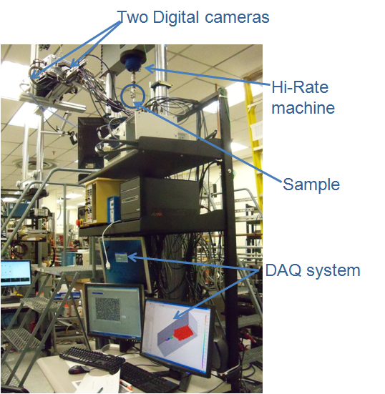
Materials and Test Instrumentation
Materials Tested:
AZ31 sheet metal
AM60B cast (top hat)
AM60B unprocessed
Materials for test development (AHSS)
Custom Designed Hydraulic System
Max Velocity=700 in/s
(18.5 m/sec) over approx. 4 in (100 mm) Range
Load Capacity : 9000 lbs (40 kN) static, 5500 lbs (25 kN) dynamic
Total Stroke: 15.5 in (400mm)
Working Stroke: approx. 7.0 in (175 mm) with slack adapter in the load train
Control: MTS 407 servo - hydraulic controllers, with external command signal (drive file). In-house developed synchronization and DAQ systems.
High speed digital imaging system
Max. Frame rate: 1000000 fps
3D imaging capability for full field displacement map
Control and synchronization of multiple data sources are essential for accuracy at high speeds.
Technical Approach

Slide 10
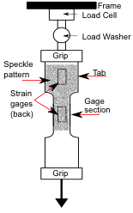
Uniaxial Tension Tests for Intermediate Strain Rate Regime Use Multiple Sensors
Test Instrumentation and Setup
Elimination of ringing in the system is the most challenging task.
Standard load cells loose accuracy at high rates due to inertia of the devices.
Strain gages on the specimen are used for strain and stress (tab region) measurements.
Optical strain measurements from high speed camera are used for strain and stress measurements across the specimen.
Measurement from different sensors is compared for different strain rates in order to establish correlations and estimate errors.
Specimen and sensor
schematics
Technical Approach

Slide 11
New Test Setup Provides for Accurate Measurements of High Strains and Rates
1 /s
500 /s
Conventional methods of calculating strains from stroke are not accurate.
  At low strain rate (1 /s), strain calculated from stroke tends to overestimate the average strain of the gage section.
  At high strain rate (500 /s), strain calculated from stroke tends to underestimate the average gage section strain.
Digital Image Correlation (VIC) enables measurement of strains well beyond the range of fast-response bondable foil gages.
Technical Accomplishments

Slide 12
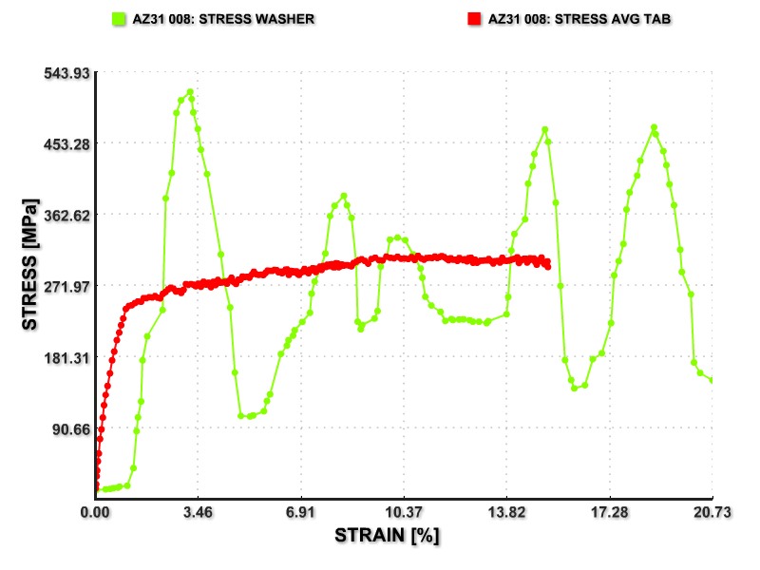
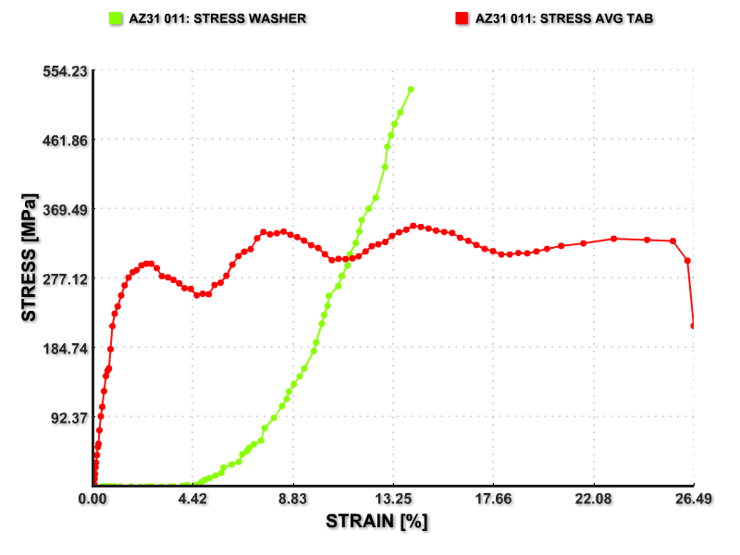
New Strain Rate Testing Method
AZ31 at 100/s
AZ31 at 500/s
Conventional method
(LVDT/Load washer)
LVDT/Load washer
New method
New method
Conventional approaches give inaccurate measurements that need to be filtered and cannot provide data for small strains and for high strain rates.
We accomplished significant improvement in measurements of stresses, strains and strain rates in the intermediate strain rate regime.
Technical Accomplishments
Notes:
Recommended time for the Accomplishments slide(s): 12-14 min
Purpose: Describe the most important technical accomplishments and results obtained in the last year.
Whenever possible, describe the significance of the accomplishments by relating the results to the appropriate VT targets and milestones from the Multi-Year Program Plan.

Slide 13
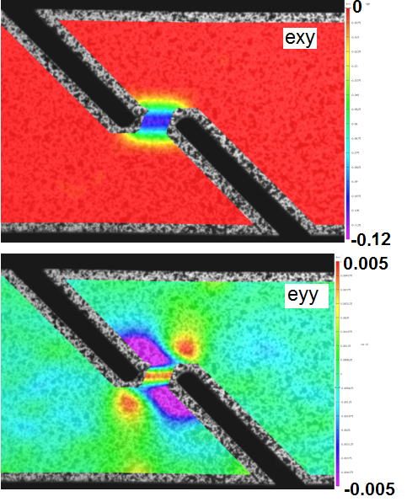
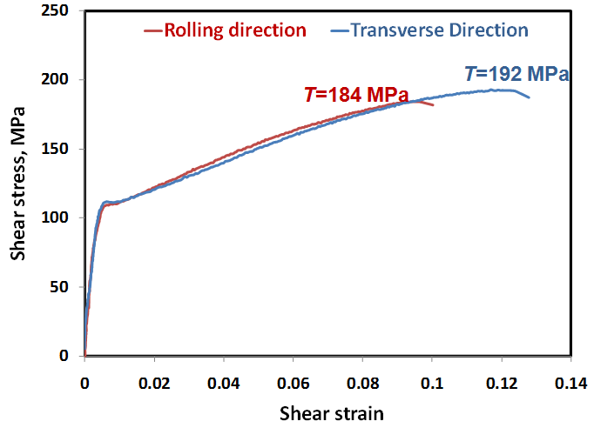
Initial Shear Tests for AM60 Have Been Successful
The tests show reasonable strain distributions in the test specimens.
Test data correlates well with the tension tests.
Y
X
Technical Accomplishments

Slide 14
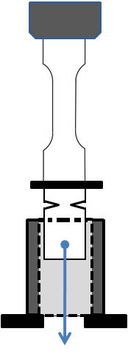
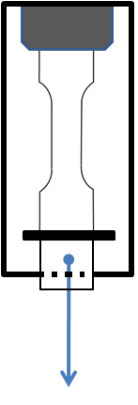
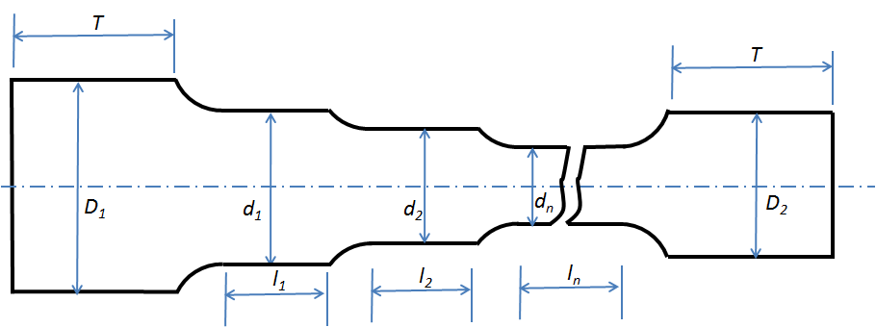
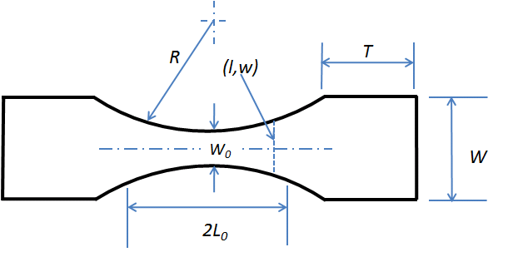
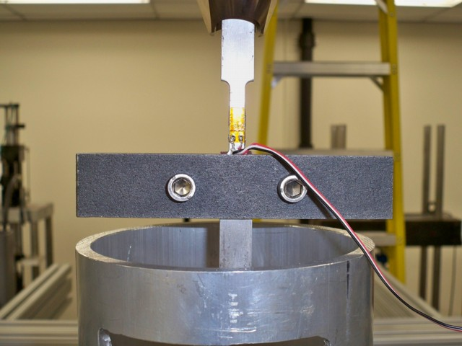
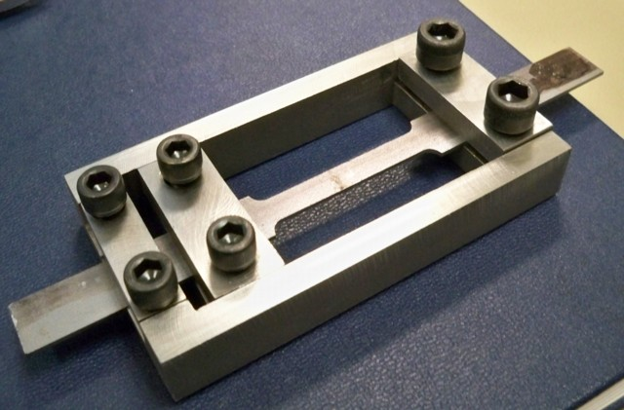
We have Designed New Test Fixtures and Specimens for Prescribed Strain Application at High Strain Rates
Attempts at New Fixture Designs
New Specimen Designs
Multi-gage
Tapered shape
Type I
Type II
Difficult to control
Problems increase with speed
Requires a large number of tests
Scrapped, went with new approach
Reduces the number of tests and specimens
Shape design is determined by modeling
No added mass, simpler, cheaper method
Invention application in process
Technical Accomplishments

Slide 15
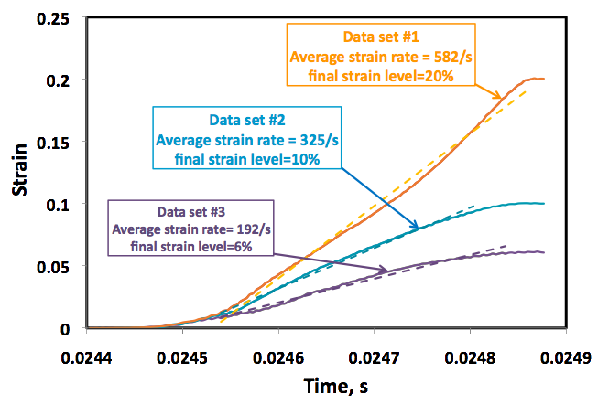
The New Test Generates Multiple Strain Rates in a Single Specimen
The new method generates smoothly increasing strain path to the final strain under reasonably constant strain rate.
Further test development is planned for in order to improve the control of strain and strain rate distribution.
Technical Accomplishments

Slide 16
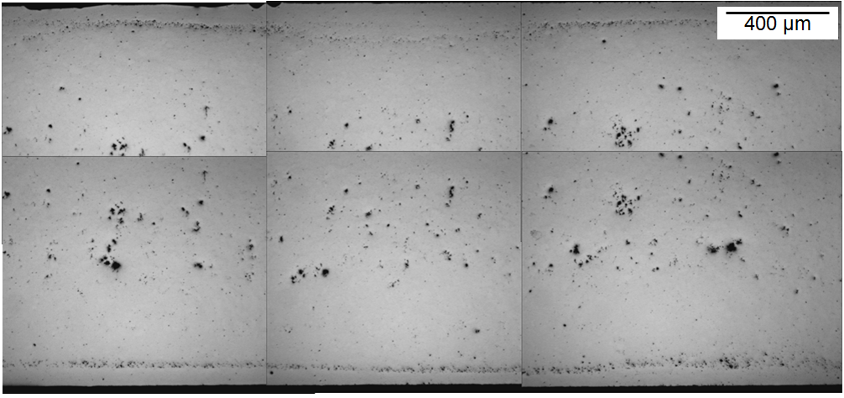


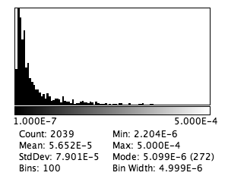
Damage Analysis in Mg Alloys
As-received AM60
Thickness Direction
Non-uniform distribution of the pores/mirostructure needs to be considered when locating the area of interest.
The void statistics are generated by image processing.
  Data can be used for calibration of micromechanics-based material and failure models for FEM simulations.
Original Image
Discovered Voids
Void Size Distribution
Technical Accomplishments

Slide 17



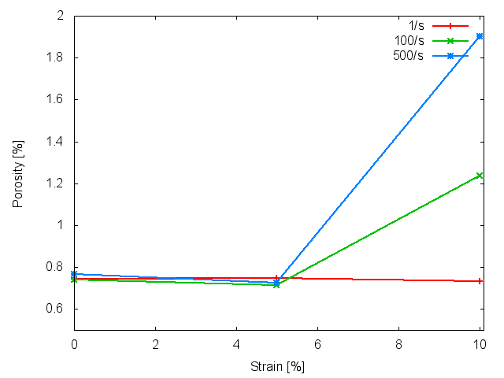
Void Profile Examples for AM60
Results are generated by the new test method
The tests show that void nucleation and growth (damage) intensifies with strain rates for AM60.
  More test are needed for different initial porosities
.
ε = 1/s
100x
Strain rate
.
ε = 100/s
.
ε = 500/s
.
ε = 100/s
Strain
0% 5% 10%
Technical Accomplishments

Slide 18
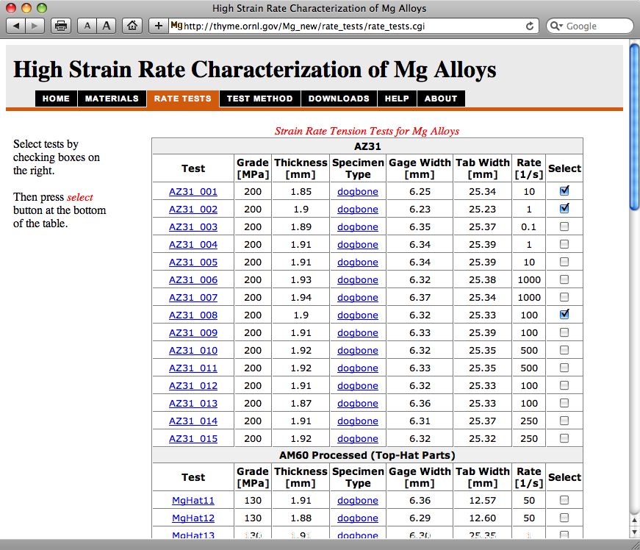
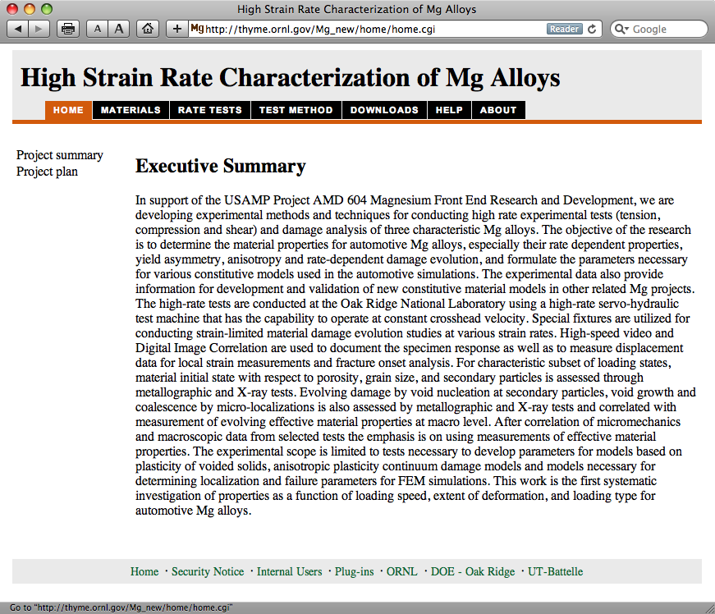
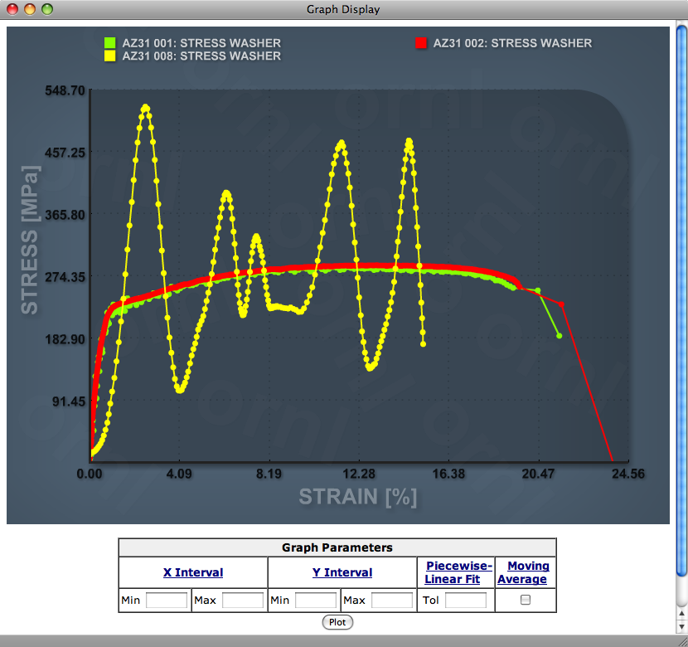
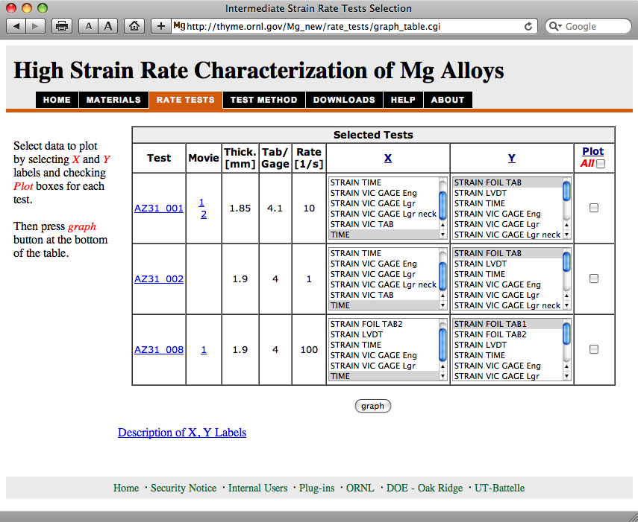
Collaboration and Coordination with Other Institutions
Collaboration with Mg Front End R&D Project
  Materials supplied by OEMs
Technology Transfer
  Test data distributed via www
    http://thyme.ornl.gov/Mg_new
  Users can select/view/process data and download it for FEM material models
  Direct communication to OEMs
Education
  Two postdoctoral students
  8 student interns so far
  9 summer students for 2011

Slide 19
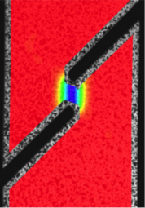



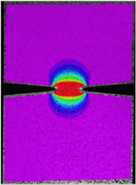
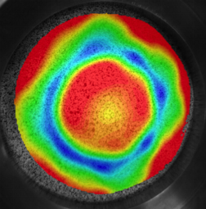
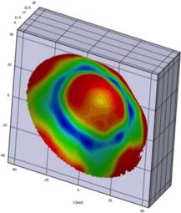
Proposed Future Work
In-depth characterization of damage evolution in Mg alloys of interest to automotive designers at various strain rate conditions, loadings and initial microstructures.
  Design new methods for tailored strain application under intermediate strain rates.
Advance technology for intermediate strain rate testing in tension, shear and multi-axial loading configurations.
  Essential for development and calibration of advanced material models for lightweight materials. The damage models require wide region of stress states and loading paths.
  Support development of forming technologies and new material processes such as asymmetric rolling for Mg alloys
Development of methods for characterization of fracture/failure properties of Mg sheet materials.
Stress Triaxiality
Notes:
Recommended time for this slide: 1 min
Purpose: Describe what will be done in the remainder of this year and in the coming year.

Slide 20
Summary
We have developed and demonstrated test methods for characterization of materials under strain rates typical of vehicle crash.
  Tension and shear configurations were developed.
  Tests provide much needed data for Mg alloy applications.
  Tests are used for material model development and calibration.
A new method for interrupted strain rate tests have been developed that enables characterization of material internal state under intermediate strain rates.
The developed expertise can be used to address complex problems of characterization of fracture and failure in sheet materials.
Technology transfer occurs via www
http://thyme.ornl.gov/Mg_new

Slide 21
Technical Back-Up Slides

Slide 22
Project Information on the WWW http://thyme.ornl.gov/Mg_new
Test Method – describes test setup and procedures
Help – usage of test data

